Slide 1
Programming Skills Workshop
Lesson 5 – Tools

Slide 2
Course Schedule
Tues 22nd – Intro
Wed 23rd – Windows Administration
Thu 24th – Windows Command Line
Wed 30th – Cancelled
Thu 31st – Programming Tips & Tricks
Wed 6th – Programming Tools
Thu 7th – Linux
Wed 13th – More Linux & Languages
Thu 14th – Group Work & More Tools

Slide 3
Course Resources
Course items up on GitHub
https://github.com/kcarta/programming-workshop
These will be updated weekly

Slide 4
Today’s Lesson
Tools! Everything from command line utilities to text editors
What you’ll learn:
Skills: How to use tools, how to debug.
Knowledge: A whole lot of tools used in daily programming work.
Values: Programmers who use tools effectively get more done, with less effort.

Slide 5
Tools

Slide 6
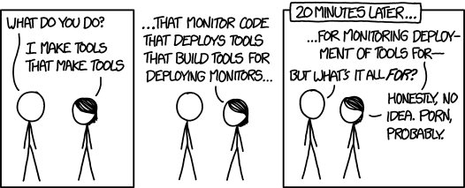
Tools
Tools are used constantly in IT Engineering. It is impossible to program without knowing and using a wide set of tools, and you will eventually start writing handy tools yourself.

Slide 7

Git
Git is a version control system (VCS)
It’s used for backing up code, tracking changes over time, sharing code between coworkers and keeping multiple version of code.
Git is the most important VCS and is used as a basis for many dependency managers (Ruby) and large open source projects (Linux, for one)

Slide 8

7-Zip
7-Zip is a free, open-source and widely compatible compression tool.
It can handle .zip and .rar files, in addition to its own .7z format.
7-Zip is the best tool on the market for many reasons. It is fine to use the built-in Windows Explorer zipping tool for common .zip files, but avoid WinRar and WinZip!

Slide 9

cURL
cURL is a command line tool for writing web requests.
It is a commonly-used utility for downloading files in Linux, as well as testing web services (especially your own)

Slide 10
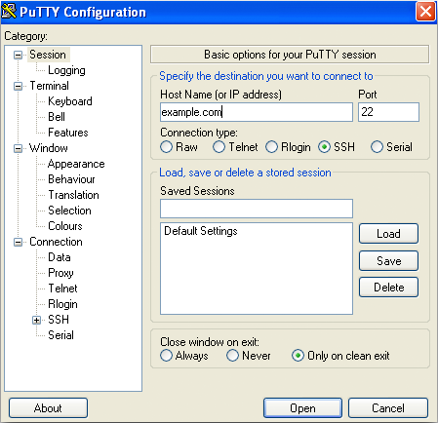
PuTTY
PuTTY is the go-to tool for remote connections to Linux servers and for serial-connected devices.
If you work with embedded devices or with remote server administration, you will probably spend a lot of time with PuTTY.

Slide 11
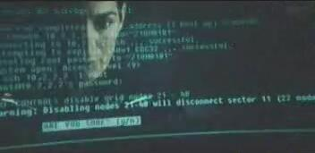
Nmap
Nmap is a network scanner. Pointed at a network or a network address, it can scan it for activity from applications or ports.
It is a popular tool for network security, but is also invaluable when troubleshooting network problems.
Nmap was famously used (correctly, even) in the Matrix

Slide 12
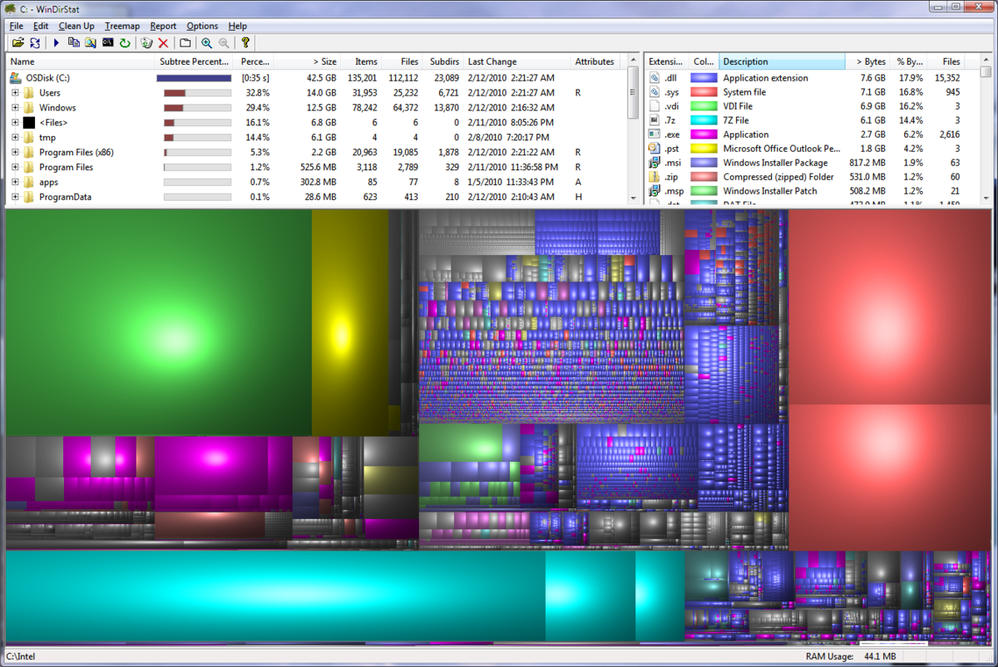
WinDirStat
Not enough space on your hard drive?
WinDirStat maps out your drives and shows you where data is being used.
It is a great tool for optimizing data usage on smaller hard drives.

Slide 13

F.lux
F.lux reduces the blue light levels from your monitor during the evening.
This keeps your eyes from “burning out” when staring at a bright screen in a dark room for too long (we’ve all been there).
Alternatively, the latest Windows 10 update has a similar feature built-in.

Slide 14
Editing Text

Slide 15
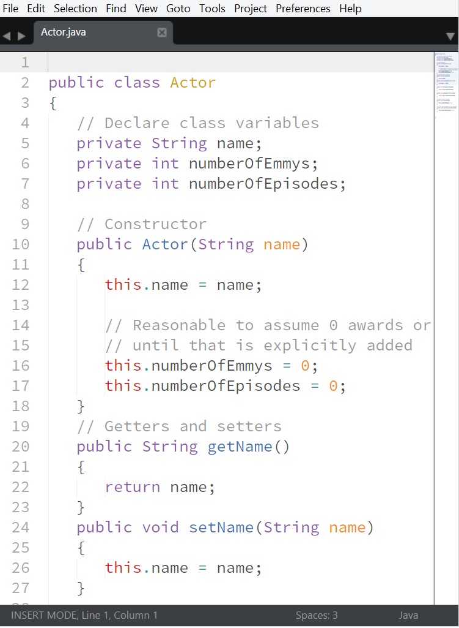
Text Editors
Text editors are tools for writing and editing text files. These files make up a program’s source code and configuration.
Notepad is the typical text editor for most people (even if it has virtually no features).
Most text editors try to make editing as easy as possible by providing keyboard shortcuts and adding color to source code.

Slide 16
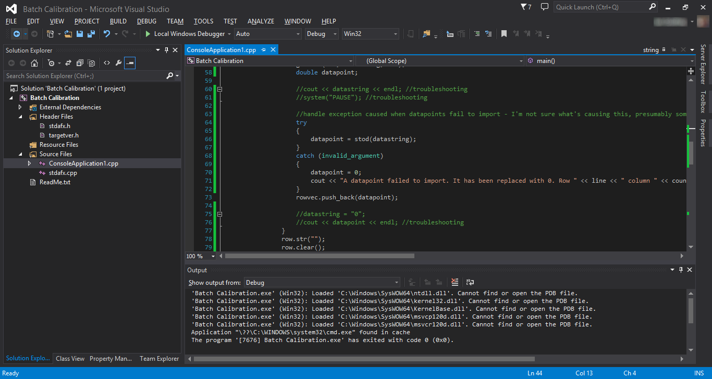

IDEs
Integrated Development Environments (IDEs) are text editors that are purpose-built for a specific language or family of languages.
Eclipse is a typical example of an IDE.
Like the cockpit of an airplane, an IDE will offer a staggering array of tools and features.
Don’t be afraid! You’ll only ever use a small set of the available tools, one tool at a time.

Slide 17


Text Editors vs. IDEs
The humble text editor is a developer’s best friend. Try them all, find one you like the most, and configure it to your heart’s desire.
An IDE, on the other hand, will often be made for a specific language or platform.
A .NET developer, for example, will use Visual Studio for most coding tasks.
Text editors can be used to edit all types of text files, but IDEs should be used for their specific purpose. It is common to use a text editor and IDE together in a project.
Make sure you are using the right tool for the job!

Slide 18
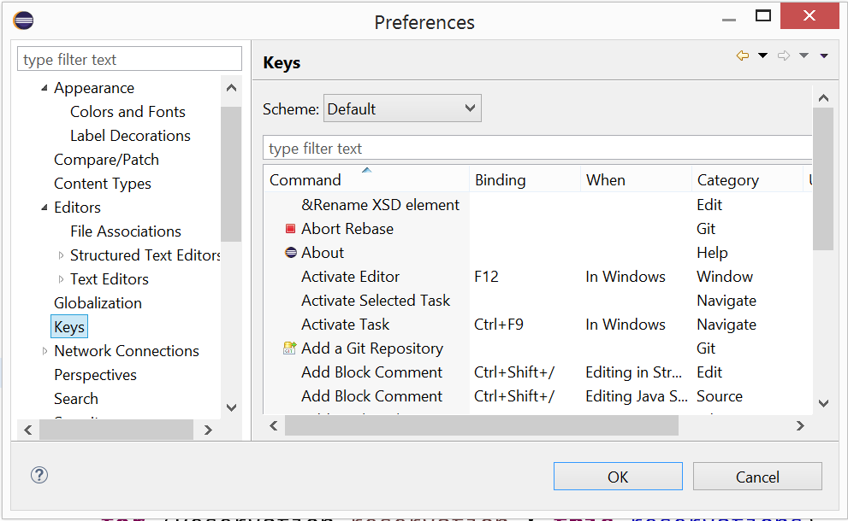
Configuring Editors
All mainstream text editors and IDEs allow customization using plugins.
Once you’re comfortable with a text editor or IDE, you’ll want to begin customizing it and installing plugins.

Slide 19
Text Editors & Visual Studio Code

Slide 20
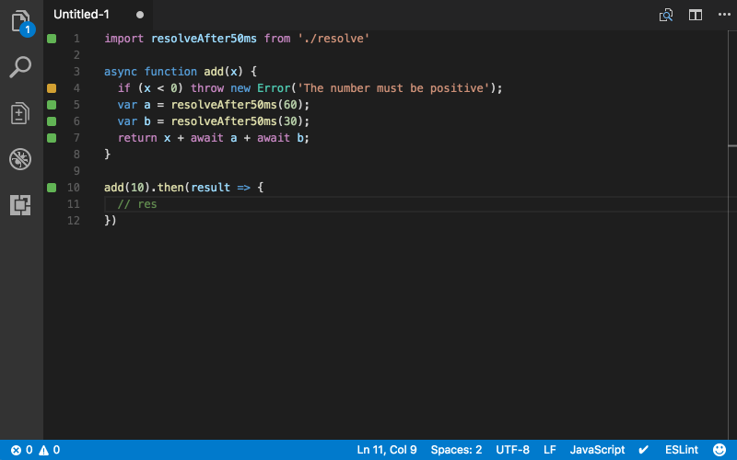
Visual Studio Code
Relatively new for a text editor
Created by Microsoft, but open source (MIT License)
Unrelated to Visual Studio IDE
Cross platform
Built-in debugging

Slide 21
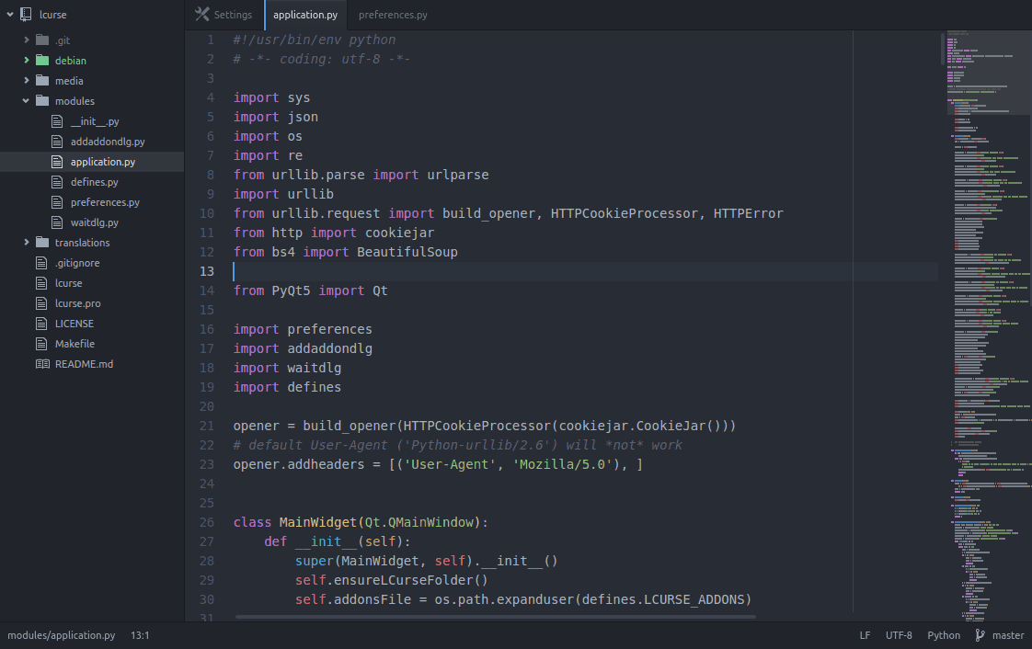
Atom
“Hackable text editor for the 21st century”
Maintained by GitHub
Open source under MIT license
Built on the same platform as VS Code (Electron)
Great for web development
Is known to suffer from performance issues

Slide 22
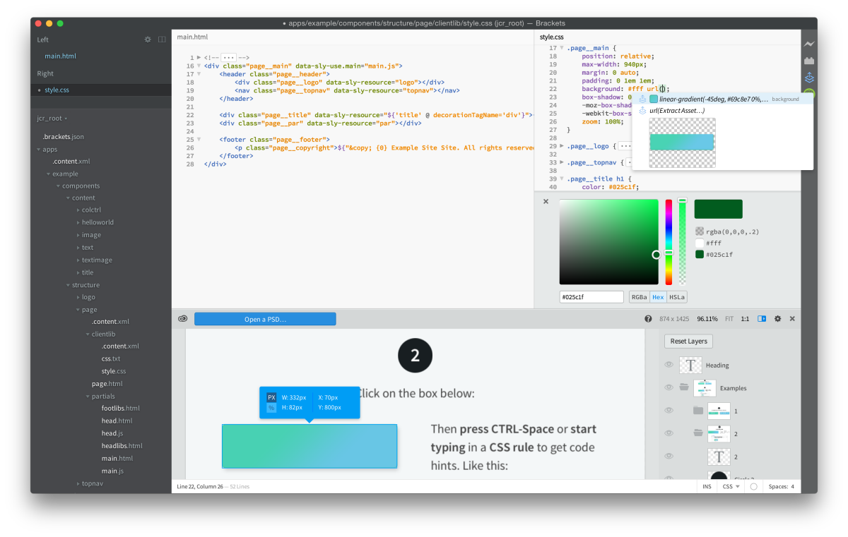
Brackets
Made specifically for web design
Maintained by Adobe
Open source under MIT license
Worse than other editors at everything but web design

Slide 23
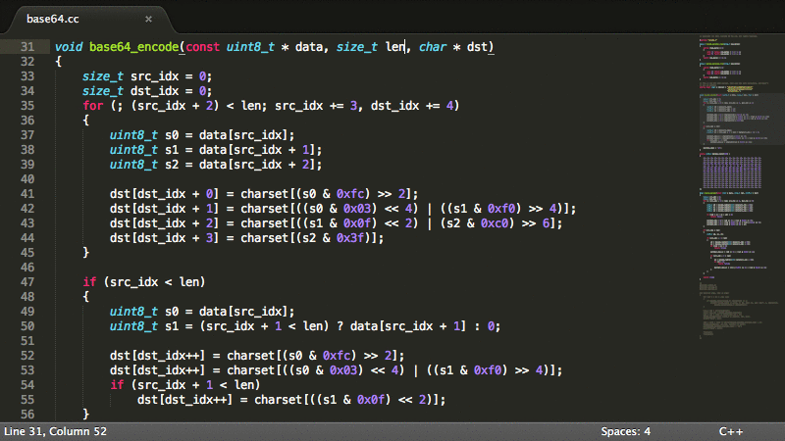
Sublime Text
Once a very popular editor
Closed source
Licensed (Free unlimited trial)
Version 3 has been in beta since 2013
Even if version 3 is in beta it’s used by 80 percent of the users

Slide 24

Vim and Emacs
Unbeknownst to the outside world, a war has been raging in the programmer community since the 1970s. The two bitter rivals are text editors: Vim and Emacs!
Vim makes editing text as smooth as possible by chaining keyboard commands.
Working with Vim feels like playing a zen video game.
Vim also comes preinstalled on Linux/Unix distributions.
Emacs is endlessly customizable, and provides commands for literally every imaginable task. Some programmers use Emacs for everything, from email to Facebook!
Richard Stallman, creator of Emacs and head of the Church of Emacs.
Source: http://en.wikipedia.org/wiki/Editor_war

Slide 25
Why I chose Code?
I used to prefer Sublime Text, but:
Sublime isn’t free, nor is it open source
It feels like it isn’t updated anymore
Visual Studio Code is faster than Atom*, and has:
A great variety of extensions
Native built-in debugging is great
Microsoft is doing a really good job with maintaining it
Notes:
David version!

Slide 26
Exercise 1: VS Code tour
Follow along as we explore text editor features in Visual Studio Code.

Slide 27
Plugins
In the past, editors had any features you could code yourself. Nowadays, editors have plugins you can easily download. Plugins are the greatest power of modern text editors
Anything from code highlight, synching settings, autoformat, etc.
Plugin managers often come built-in
Ease-of-use of plugins is a big factor in choosing a text editor
Sublime vs Code
A vim plugin, for example, is pretty common to find in text editors

Slide 28
Exercise 2: VS Code Plugins
Let’s install some plugins in Visual Studio Code.

Slide 29

What a Text Editor isn’t
A text editor is not an IDE, even if it can “become” like one
Text editors are for single files and short scripts
IDEs are for projects
For any platform there is usually a better IDE
Text editors can be great companions to IDEs
You really don’t want to use Brackets for Java!

Slide 30
IDEs & Eclipse

Slide 31

Eclipse
Eclipse is the most popular* IDE for Java.
It is not actually just one tool, but a large group of tools collected together into a single program.
Eclipse has all sorts of handy features:
Project management (build tools, source control)
Code completion
Debugging

Slide 32
Eclipse Workspaces
Workspace
Project
Project
Package
Package
…
Package
Package
…
Eclipse uses a single Workspace at any time. You can switch workspaces as needed.
Inside a workspace is multiple Projects.
Projects are further divided using folders and Java Packages.
It’s okay to not use packages in your own code until you’re more experienced

Slide 33
Eclipse Workspace Setup
Use Preferences -> General -> Startup and Shutdown -> Workspaces to have Eclipse set a default workspace in your preferred programming folder.
A good choice would be: C:\src\java
Use File -> Switch Workspace to change workspaces between classes and projects. This is a good idea for your semester project code.

Slide 34
Eclipse Editor Functions
Eclipse is more than just a text editor!
Eclipse has a large number of helpful tools for working with Java :
Source code editing, such as autocomplete
Refactoring tools (awesome for maintaining large projects)
Project navigation and code search (also great for large projects)
Build tools
An easy-to-use debugger

Slide 35
Eclipse Autoformating
Do you like to type sloppy and clean up later? Eclipse can help!
Type Ctrl + Shift + F to have Eclipse autoformat (“pretty print”) your code.
In Window -> Preferences -> Java -> Code Style - > Formatter you can change and add code styles
Google’s style guide (github.com/google/styleguide/blob/gh-pages/eclipse-java-google-style.xml) is a good standard to follow.
If you want to autoformat code in a whole project, you can right-click on the project and select Source -> Format

Slide 36
Exercise 3: Autoformatting
Open the Calculator.java file in Eclipse (yes, it is really ugly).
Try manually formatting it.
When that gets old, autoformat it in Eclipse with Ctrl + Shift + F
What does autoformatting fix?
What does it not fix?

Slide 37
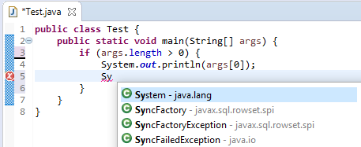
Eclipse Autocomplete
Be lazy! Don’t type long words manually!
Using Ctrl + Space, Eclipse will finish words for you.
This is a great way to write easily-misspelled class and variable names.

Slide 38
Eclipse Snippets
Tired of writing System.out.println by hand? Eclipse can help!
Eclipse lets you use snippets (“templates”) to generate code.
To expand a snippet, write the keyword and press Ctrl + Space
Common snippets include:
sysout -> System.out.println()
for -> for loops (with iterator i)
ifelse -> if/else statement
Go to Window -> Preferences -> Java -> Editor -> Templates to view/edit these

Slide 39
Exercise 4: Practicing Autocomplete
Let’s practice autocomplete together!

Slide 40
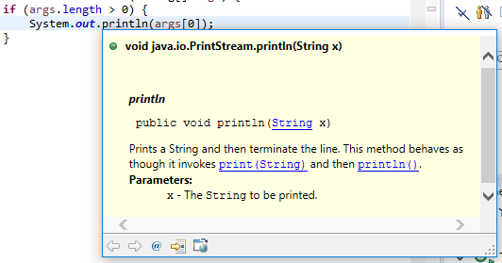
Eclipse Code Completion
Code Completion (“intellisense”) is a common feature in IDEs. It is your new best friend.
Eclipse tells you what a class or method does - without you having to look it up in documentation!
To activate this feature, simply hover your mouse over a class, method or variable.
Javadoc comments combined with code completion make it easy to code with Java libraries!

Slide 41
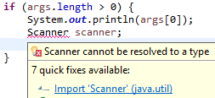
Eclipse Package Imports
To do anything useful in Java, you will need to use packages.
Packages can either be in the Java SDK (you’ve been using it without knowing it), or from an external source.
Eclipse will help you auto-import packages as you need them.
Using Ctrl + Shift + O will import any classes that you have attempted to use.

Slide 42
Exercise 5: Explore Java APIs
Use the package import and intellisense in Eclipse to explore the following Java SDK APIs (type them in exactly as shown. Press Ctrl + Space if needed):
Math.
Files.
java.util.
What functionality do these contain?
What do you recognize?
Can you find everything you need to know about these using only Eclipse, or do you need to use Google too?

Slide 43
Good to know: IntelliJ
IntelliJ is an IDE for Java and many other languages/platforms.
IntelliJ offers a slew of integrated tools, and is often preferred to Eclipse as a modern Java IDE.
Take a look and see which one you prefer.*
* Not recommended for beginners!
It can be a challenge to share projects between Eclipse and IntelliJ)

Slide 44
Good to know: Visual Studio
Visual Studio is used for programming in the .NET ecosystem (not with Java).
It contains tools and templates for a vast range of project types.
It is so popular that it is rare to program in .NET using any other tool!

Slide 45
Debugging

Slide 46
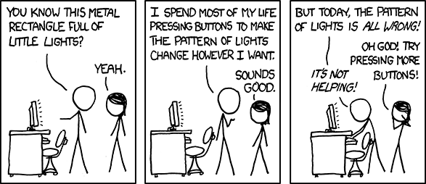
Debugging Introduction
Code fails. Bugs are a fact of life.
Debugging is the art of catching bugs in a running program.

Slide 47
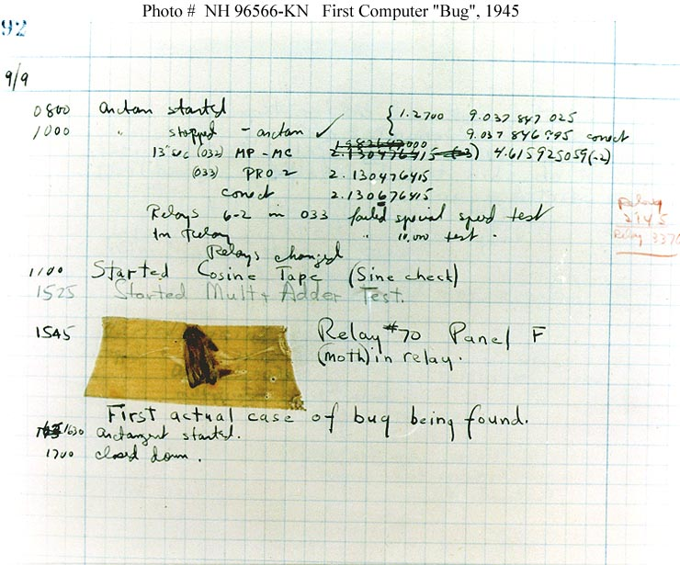
Debugging Strategies
Debugging is an act as old as programming itself.
Most bugs cannot be found just by looking at code.
The best way to track down bugs is to run a program and watch it fail – you want to get the computer to show you what it’s doing.
Many strategies exist for debugging. We’ll cover the two most common.

Slide 48
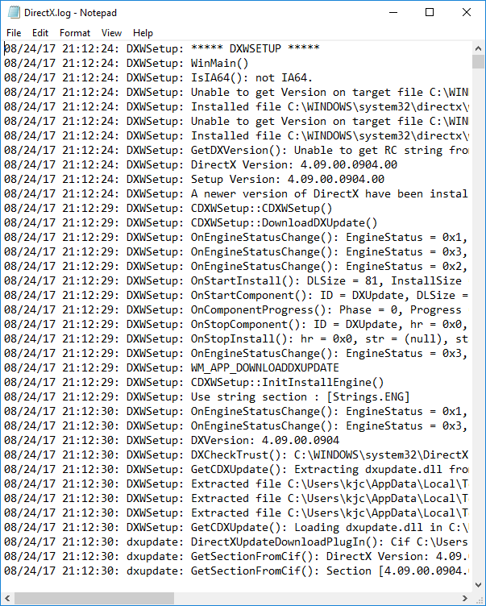
Debugging with print statements
All programming languages have a way to print text output to a log, either in a file or a console window.
Printing program output to a debug log is called using a print statement. This is a very fast and easy technique.
This is also common practice in low-level platforms that lack tool support for debugging.
In Java, print statements are produced using System.out.println

Slide 49
Exercise 6: Debugging with print statements
A common tactic for using debug statements is to place them around the area where you think the bug occurs, then move them closer together until you have located the bug precisely.
Use this tactic and System.out.println to debug the IncrementingCounter.java program.
- How could you have solved this bug without using print statements?

Slide 50
Using a debugger
Print statements are a very primitive technique, and aren’t interactive.
A modern debugger will literally pause your program while it is running, and let you view and even change the current values.
Using a debugger, you can step through code one line at a time to see exactly where bugs occur.
A debugger is not magic! It just feels like it.

Slide 51
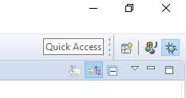
Debugging in Eclipse
Tools like the Eclipse debugger make debugging an intuitive process.
To open the debugger, choose Run -> Debug, hit F11, or use the debug perspective button.
Eclipse has a weird “perspective mode” for its debugger.
When done debugging, you can switch back to normal mode with the perspectives button in the upper-right of the program.

Slide 52
Debugging Process
The normal debugging process is simple (and the same in most IDEs):
Place breakpoints in your code
Run the program in debug mode
The program will pause at each breakpoint
Use the inspector to view the values of variables
Use Step Into or Step Over to advance to the next line (and repeat step 3).
Step Into will enter into any method that is called on the current line
Step Over will skip over any method that is called on the current line
Use Resume to continue your program (until the next breakpoint).
Alternatively, you can pause a running program at any time.

Slide 53
Exercise 7: Debugging
Let’s practice using the Eclipse debugger!
Find (and fix, if you know how) the bug(s) in CliCalculator.java and IncrementingCounter.java
- Which program is easier to debug with the debugger? Why?

